Slide 1
Data Base System Week 5th Topics
Database Development & Design
Database Development Strategies
DBDLC

Slide 2
Data Base System Week 5th Topics
Database Development Process
is a lengthy and complicated process
General Strategies
A DB is developed to satisfy the requirements of the users and understand these requirements in detail
the requirements should be defined as early as possible
Top-Down Approach
Starting from general issues and moves to specific issues
First of all to find out general goals of the organization and how to achieve these goals
The requirements should be defined to reach these goals
Bottom-Up Approach
Starting from specific issues and moves to general issues
To develop a specific system
Requirements are found by studying the existing system and interviewing different users

Slide 3
Data Base System Week 5th Topics
Database Development Life Cycle
A repetitive process in which system may be manipulated, upgraded, matured in its operations and may introduce new hardware and software technologies due to environmental changes(Government policies or users demands)
It is a complex and tedious process and a conventional way to develop an information system
The stages (steps) involved are not logical but involve some repetition
Either for new or to upgrade a system
correcting faults,
implementing new user requirements,
modifying software to run on new or upgraded platforms.

Slide 4
Data Base System Week 5th Topics
Database Development Life Cycle
Software Depression
As a result, many major software projects were
Late
over budget,
unreliable,
difficult to maintain,
performed poorly.
In late 1960s, led to ‘software crisis’, now refer to as the ‘software depression’
Major reasons for failure of software projects includes:
- lack of a complete requirements specification;
- lack of appropriate development methodology;
- poor decomposition of design into manageable components.
Structured approach to development was proposed called information systems lifecycle.
Information System
Resources that enable collection, management, control, and dissemination of information throughout an organization.

Slide 5
Data Base System Week 5th Topics
Database Development Life Cycle
Database is fundamental component of I.S., and its development/usage should be viewed from perspective of the wider requirements of the organization
Steps in DBDLC
Database planning
System definition
Requirements collection and analysis
Database design
DBMS selection (optional)
Application design
Prototyping (optional)
Implementation
Data conversion and loading
Testing
Operational maintenance.

Slide 6
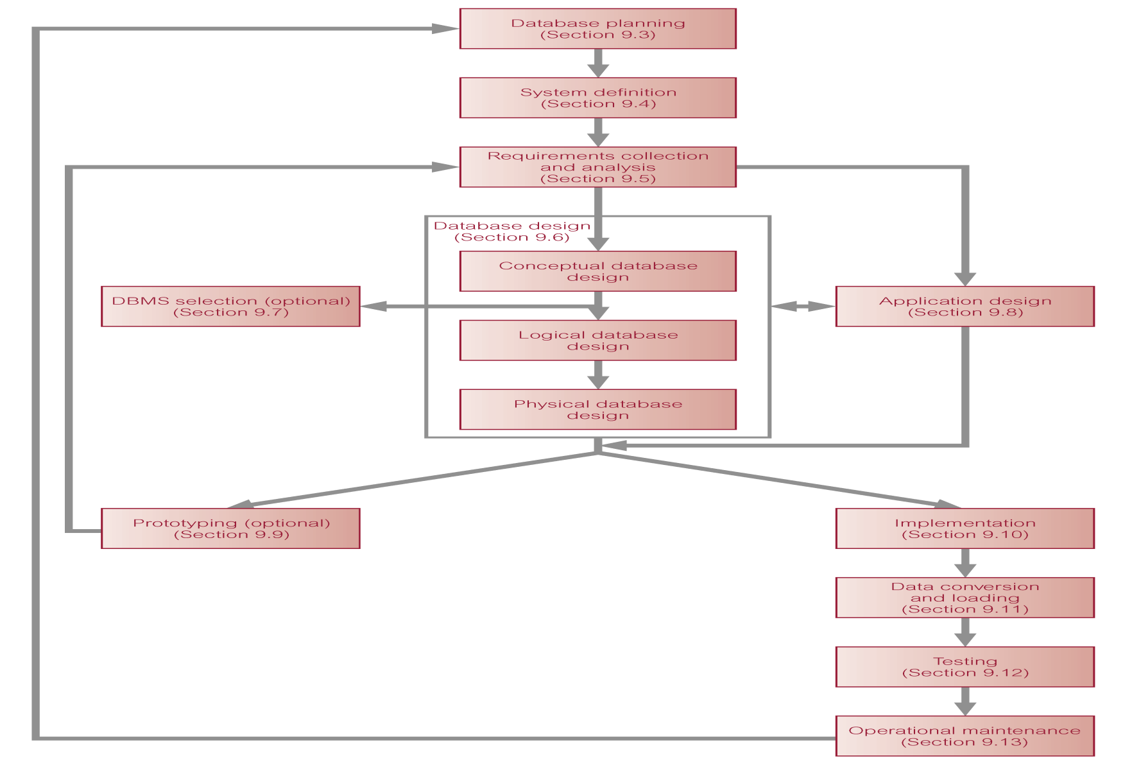
Data Base System Week 5th Topics

Slide 7
Data Base System Week 5th Topics
Database Planning
Performed at the top level and must be integrated with overall IS strategy of the organization
Mission statement for the database project defines major aims and clarify purpose of the database project and provides clearer path towards the efficient and effective creation of required database application
May be accompanied by some additional information that specifies the work to be done, the resources with which to do it, and the money to pay for it all
Database planning should also include development of standards that govern:
how data will be collected,
how the format should be specified,
what necessary documentation will be needed,
how design and implementation should proceed.

Slide 8
Data Base System Week 5th Topics
System Definition
Describes scope and boundaries of database application and the major user views
Database application may have one or more user views.
Identifying user views helps ensure that no major users views of the database are forgotten when developing requirements for new application.
User views also help in development of complex database application allowing requirements to be broken down into manageable pieces
Present needs and future needs
Requirements Collection and Analysis
The most critical step also called problem identification i.e. to find out the problems and their reasons
Process of collecting and analyzing information about the part of organization to be supported by the database application, and using this information to identify users’ requirements of new system

Slide 9
Data Base System Week 5th Topics
Requirements Collection and Analysis
Information is gathered for each major user view including:
a description of data used or generated;
details of how data is to be used/generated;
any additional requirements for new database application.
Information is analyzed to identify requirements to be included in new database application
Reasons
The current system is difficult to use
Current system don’t work accordingly
Current system producing inaccurate results
Current system needs improvements
Role of System Analyst
Begins a preliminary investigation to find out the problems and its sources
Prepares and submit a report to organization
Request for approval of project

Slide 10
Data Base System Week 5th Topics
Role of System Analyst
The report contains the following
Problem definitions
Cost for their solutions
Time duration
Staff required
Hardware and software technologies
Analysis
After project approval system analyst investigate the system in detail by using the following analysis techniques
Review of Physical Records
Interviews
Questionnaire
Observation

Slide 11
Data Base System Week 5th Topics
Database Design
Process of creating or designing a database that will support the enterprise’s operations and objectives
Major aims:
Represent data and relationships between data required by all major application areas and user groups.
Provide data model that supports any transactions required on the data.
Specify a minimal design that is appropriately structured to achieve stated performance requirements for the system (such as response times).
Three phases of database design:
Conceptual database design
Logical database design
Physical database design

Slide 12
Data Base System Week 5th Topics
Conceptual Database Design
Process of constructing a model of the information used in an enterprise, independent of all physical considerations.
Data model is built using the information in users’ requirements specification.
Source of information for logical design phase
2. Logical Design
Conceptual data model is refined and mapped on to a logical data model.
Means different algorithms, flowcharts are designed e.g. DFD, ERD
Logical design provides a clear understanding and roadmap about the proposed system
3. Physical Design
Process of producing a description of the database implementation on secondary storage.

Slide 13
Data Base System Week 5th Topics
3. Physical Design
Describes storage structures and access methods used to achieve efficient access to data.
Tailored to a specific DBMS system
DBMS Selection
Selection of an appropriate DBMS to support the database application.
Undertaken at any time prior to logical design provided sufficient information is available regarding system requirements.
Main steps to selecting a DBMS:
define Terms of Reference of study;
shortlist two or three products;
evaluate products;
recommend selection and produce report

Slide 14
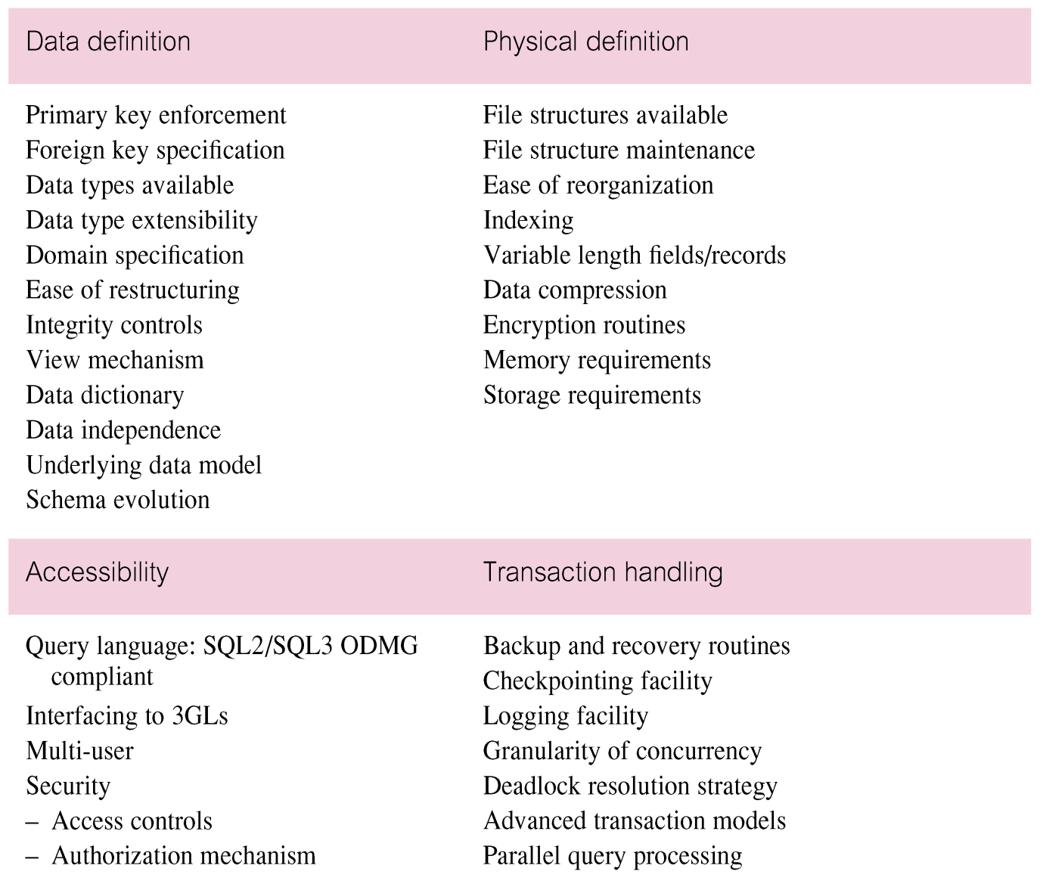
Data Base System Week 5th Topics

Slide 15
Data Base System Week 5th Topics
Application Design
Design of user interface and application programs that use and process the database.
Database and application design are parallel activities.
Includes two important activities:
transaction design;
user interface design.
Transactions
An action, or series of actions, carried out by a single user or application program, which accesses or changes content of the database
Important characteristics of transactions:
data to be used by the transaction;
functional characteristics of the transaction;
output of the transaction;
importance to the users;
expected rate of usage.
Three main types of transactions: retrieval, update, and mixed.

Slide 16
Data Base System Week 5th Topics
Prototyping (Optional)
Building working model of a database application.
Purpose
to identify features of a system that work well, or are inadequate;
to suggest improvements or even new features;
to clarify the users’ requirements;
to evaluate feasibility of a particular system design.
Implementation
Physical realization of the database and application designs.
Use DDL to create database schemas and empty database files.
Use DDL to create any specified user views.
Use 3GL or 4GL to create the application programs. This will include the database transactions implemented using the DML, possibly embedded in a host programming language.

Slide 17
Data Base System Week 5th Topics
Data Conversion and Loading
Transferring any existing data into new database and converting any existing applications to run on new database.
Only required when new database system is replacing an old system.
DBMS normally has utility that loads existing files into new database.
May be possible to convert and use application programs from old system for use by new system
Testing
Process of executing application programs with intent of finding errors.
Use carefully planned test strategies and realistic data.
Testing cannot show absence of faults; it can show only that software faults are present.
Demonstrates that database and application programs appear to be working according to requirements
Two types of testing are: unit and integrated

Slide 18
Data Base System Week 5th Topics
Operational Maintenance
Process of monitoring and maintaining system following installation.
Monitoring performance of system.
if performance falls, may require tuning or reorganization of the database.
Maintaining and upgrading database application (when required).
Incorporating new requirements into database application.
Feed Back
Request can be send back to planning stage to solve the problems and improve the system accordingly

